Slide 1

Credit Risk Analysis
By: Wahyu Dimas Nur Hadian Shah
Linkedin: https://www.linkedin.com/in/wahyudimas/
Github: https://github.com/wahyudims?tab=repositories

Slide 2
Table of contents
01
Business Background
and Objectives
02
03
Data Preparation
EDA
04
05
06
Conclusion &
Recommendation
Features Engineering
Modelling

Slide 3

Business Background and objective 01

Slide 4


Context
At this era. Credit card has been a primary commodity for most of the people especially in nowadays where you could buy anything online. Credit card offers a good services in which you as a client could use your credit card to buy anything you want as long as it is under the limit and pay it later. But it has a downside too which often client isn’t responsible with his credit card usage which causes a late credit card payments. That’s why credit card company often doing some check to their client to predict whether these clients will become default or not.
Objective
What kind of client that has tendency to be default client?
What kind of machine learning model that suitable to predict default of a client?
What is the impact of the model to the business?

Slide 5

Data preparation 02

Slide 6
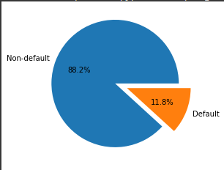
Overview
The data is split into two datasets. The first one is application_record.csv which contains personal information of each client with 438557 rows of data. The second one is credit_record.csv which contains every record of each credit transaction for each customer which contains 1048575 rows of data.
These datasets have 18 features which have 12 categorical features and 6 numerical features with the target is the status whether the client is default or not
Categorical features | Numerical features
CODE_GENDER FLAG_OWN_CAR FLAG_OWN_REALTY NAME_INCOME_TYPE NAME_EDUCATION_TYPE NAME_FAMILY_STATUS NAME_HOUSING_TYPE FLAG_MOBIL FLAG_WORK_PHONE FLAG_PHONE FLAG_EMAIL OCCUPATION_TYPE | CNT_CHILDREN AMT_INCOME_TOTAL DAYS_BIRTH DAYS_EMPLOYED CNT_FAM_MEMBERS MONTHS_BALANCE

Slide 7

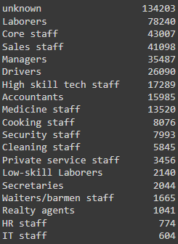
Handling missing value
As we can see there are missing values in features occupation type which is around 134203 rows or 30.6% of total data. This number is quite high so we can’t just drop it. Because we don’t have any additional info according to this missing value for now we will change the missing values into a value ‘unknown’

Slide 8

Exploratory Data analysis (eda) 03

Slide 9

Deep Dive questions
There are several questions that I tried to answer in this project
How is the characteristics of the clients?
How is the characteristics of clients who intends to become default?
At what period does the client tend to default more?

Slide 10
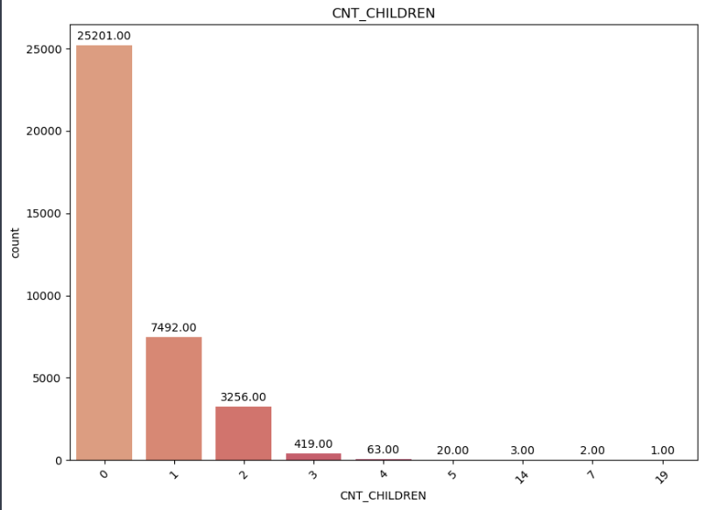
How is the characteristics of the clients?
Most client don't have any children which is around 63.8% of total client

Slide 11
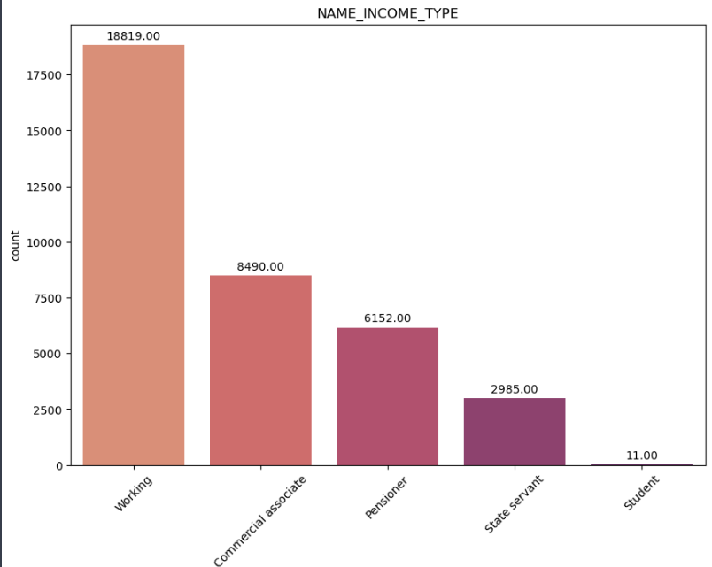
Most client has income type of working which is around 52% of total client

Slide 12
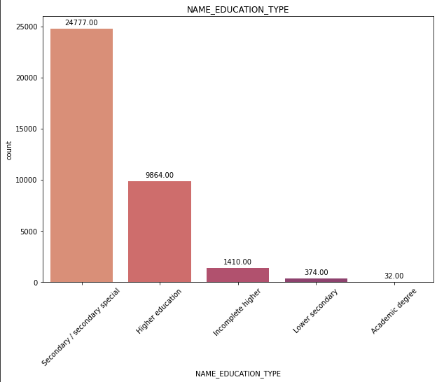
Most client's education are on Secondary special which is around 70% of total client

Slide 13
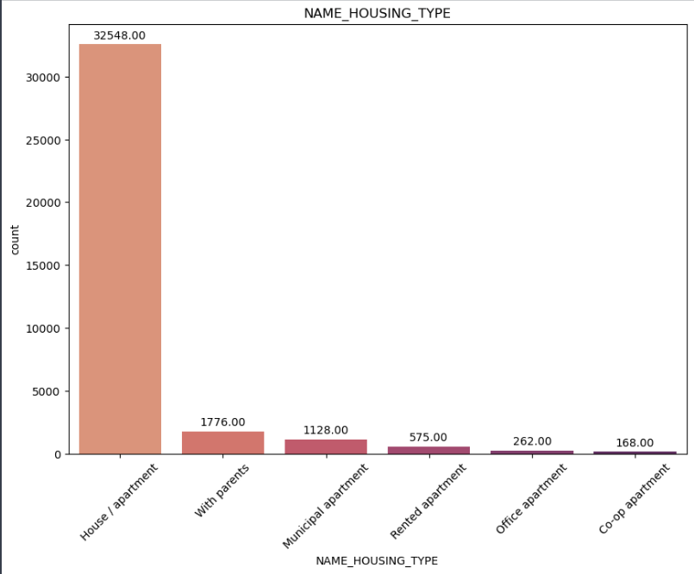
Most client has house / apartement.

Slide 14
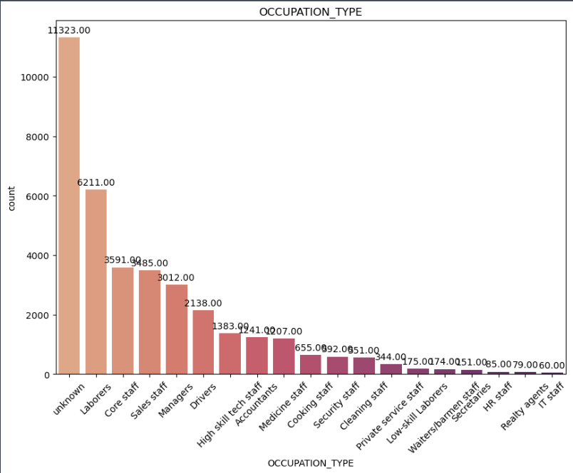
30% of the client has unknown occupation. But the second highest occupation is Laborers which around 17% of client

Slide 15
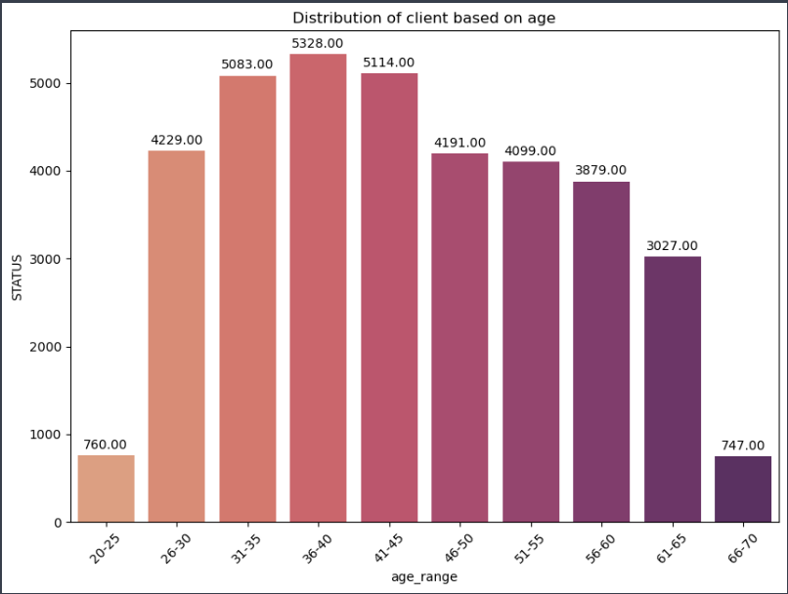
Most clients are around age of 31-45 years old

Slide 16
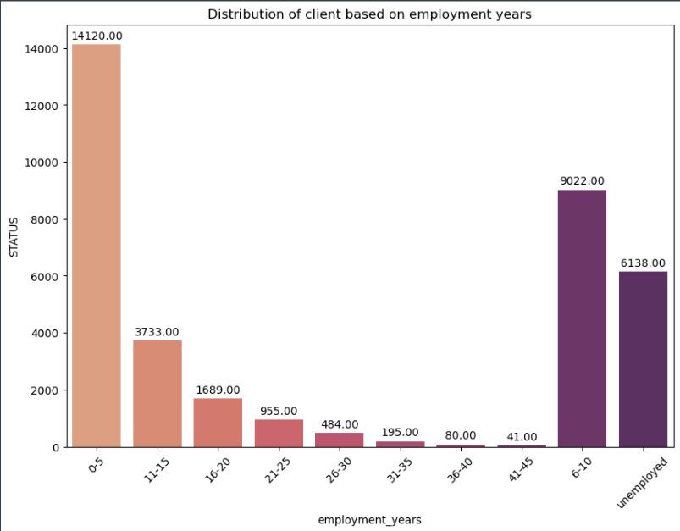
Most clients dominated by people who had been working for 0-10 years

Slide 17
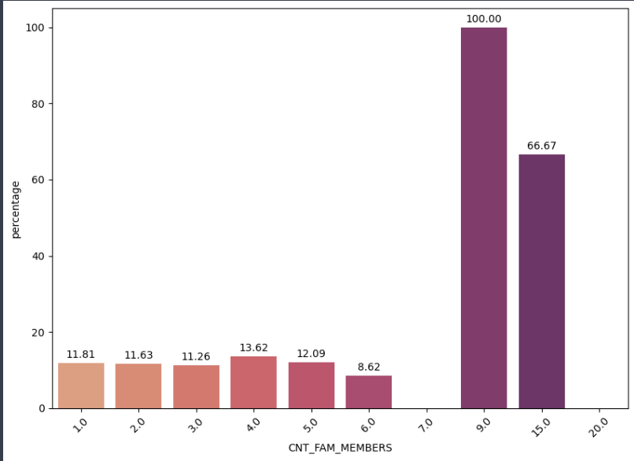
How is the characteristics of clients who intends to become default?
The more family members the percentage of the trend of default client is increasing

Slide 18
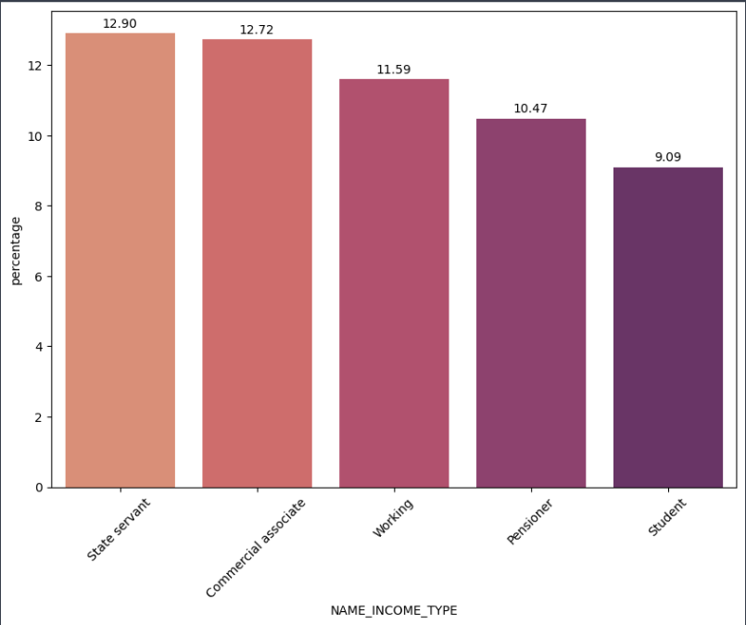
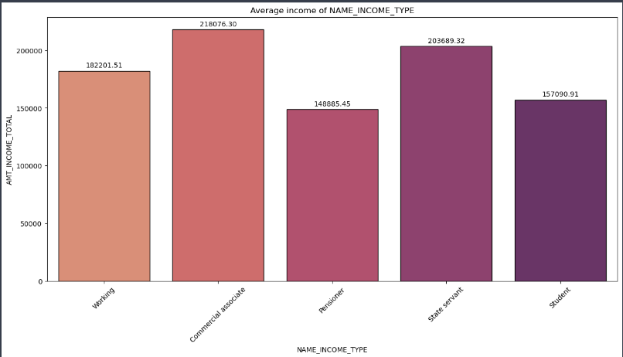
State servant and Commercial associate has the highest annual income compared with the others but has the higher percentage of default client which are around 12.9% and 12.72% of them are default.

Slide 19
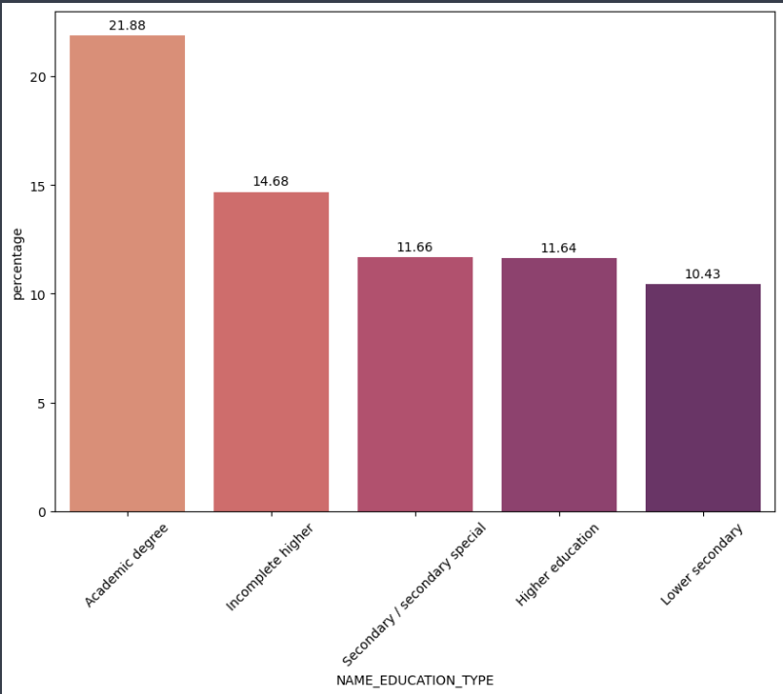
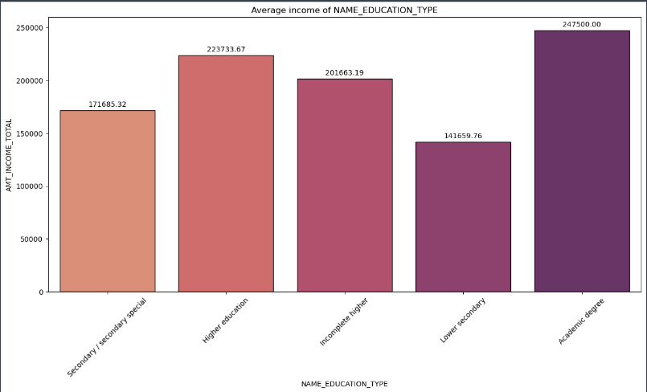
Academy education contributes the most default client compared among other education level which is around 21.88%

Slide 20
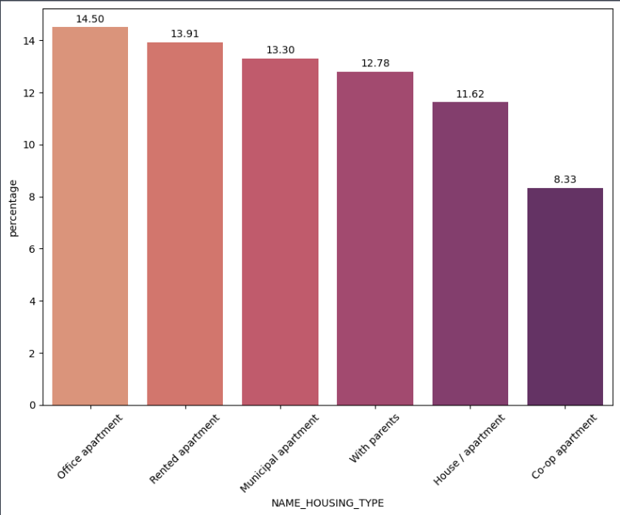
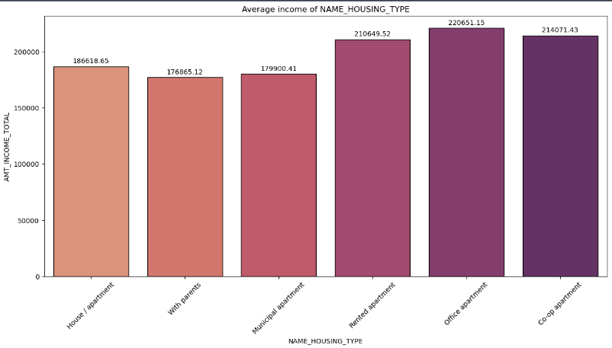
Client who lives in office apartment has the highest risk among other housing type which is around 14.5% even though they have the highest annual income compared with the others

Slide 21
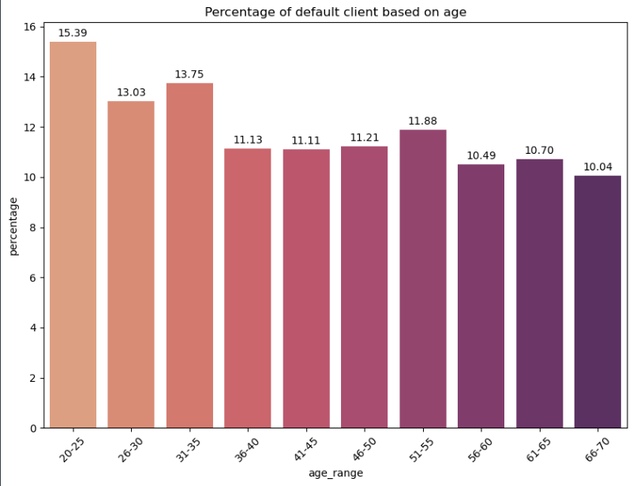
Most default clients are dominated by clients around 20 – 35 years old

Slide 22
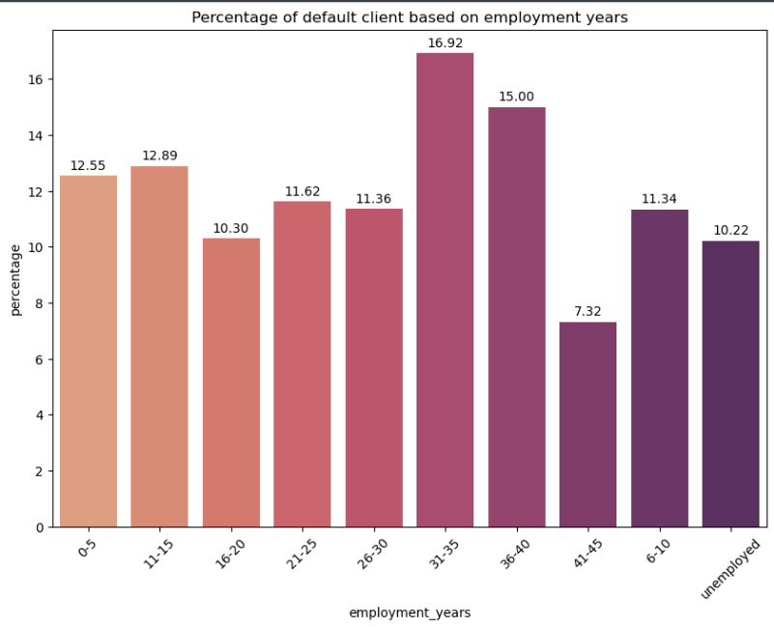
Most default clients are dominated by clients who has employment years of 31-40 years

Slide 23
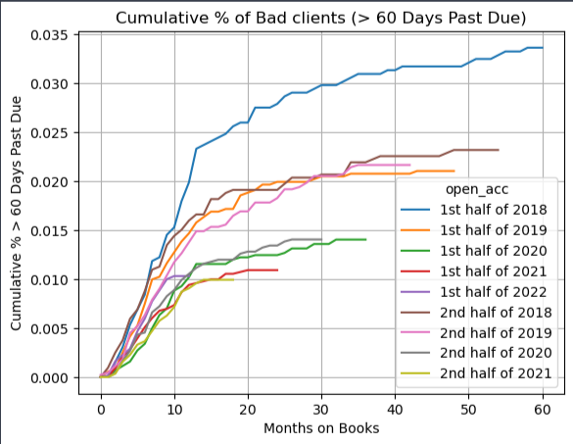
At what period does the client tend to default more?

Slide 24

Features engineering 04

Slide 25
Features engineering
Aspect | Action
Handling Categorical Features | Categorical features with 2 distinct value Binary Encoding (FLAG_CAR, CODE_GENDER, FLAG_REALTY) = Binary Encoding Categorical features with ranking (Education) = Ordinal Encoding Else = One-hot Encoding
Drop Features | ['ID','DAYS_BIRTH','MONTHS_BALANCE','FLAG_WORK_PHONE','FLAG_EMAIL', 'FLAG_MOBIL', 'DAYS_EMPLOYED', 'CNT_CHILDREN’]
Imbalance Data Handling | Undersampling
Scaling | StandardScaler

Slide 26

modelling 05

Slide 27
Machine learning algorith
Model | Recall
Logistic Regression | 53%
Decision Tree | 73%
Random Forest | 80%
Support Vector Classifier (SVC) | 78%
K-Nearest Neighbors (KNN) | 86%
Neural Network | 71%
This model used Principal Component Analysis (PCA) to reduce the total features from 56 features to 25 features
The dataset split with 75:25 ratio which means 75% data become training data and the remaining become test data.
As the metric, we chose ‘Recall’ as the metric because in credit risk analysis, we want to minimize the false negative scenario where we predict the customer won’t be default but the actual is they’ll become default. It could cause the company to loss profit more.
The best algorithm to use is K-Nearest Neighbors with the value of recall is 86%

Slide 28
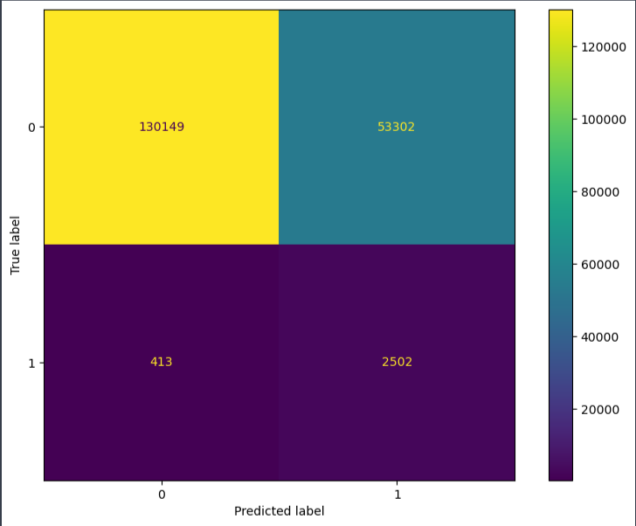
Confusion matrix
From the confusion matrix we can analyze that the model has True Positive Rate of 86% means from 2915 clients that our model predicts will become defaults, 86% of them or 2502 of them will exactly be default!!.

Slide 29
Potential impact on bussiness
Let’s assume that there are 1000 clients who are labeled as default customer. Using this model, we could make sure that from those 1000 clients. 860 of them really are default customer. Let’s say for each default customer the company has a loss of $10. It means the company can save up to $8,600.00 by using this model!.

Slide 30

Conclusion & Recommendation 06

Slide 31
Conclusion & Recommendation
There are some dominant characteristics among the clients which are have no children, who are working, have secondary education, have house or apartment, are laborers, around age 31-45 years old and have been in employment for around 0-10 years. The marketing team can focus their effort into promoting advertisement into this group.
There are some dominant characteristics among the clients who are default clients which are the more family members they have the more they become default, who are state servant, have academic degree, and are around 20-35 years old. The approval team can keep their eyes on this particular group and check their record closely to make sure could they will not become default client.
Annual doesn’t always positively correlated with probability of becoming default client. For example, as we can see in income type, education level, and housing type the highest category that has higher annual income tend to have bigger percentage of default client.
From vintage analysis we could see that the percentage of client becoming default is increasing rapidly around 0-15 month of the ongoing credit. After that, the percentage of client becoming default is increasing steadily. The approval can use this insight to approve people who has crediting for more than 15 month more easily. And team marketing can also focus more on this group to advertise their services.
The best model in this case is KNN which gives recall around 86%. This model can be used in an application in which approval team could insert the personal information and credit information of clients who applied, then this model could predict would this client be default or not and from there it can be consideration to approve the client or not.

